Slide 1
Reinforcement Learning for Maze solving
NISHANTH. VANIPENTA
UID:116409605
Notes:
Good evening everyone, I have chosen my final project as maze solving in a complex environment through the machine learning method using Q learning Algorithm.

Slide 2
Outline
Introduction
Problem Overview
Reinforcement learning problem
Algorithm
Demonstration and Analysis
Conclusion
Notes:
So, here’s the quick overview of the slides that I am going to present

Slide 3
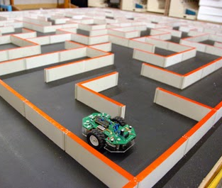
Introduction
Q-Learning is a popular method to solve many problems by training an AI system. In our approach, a maze solving learning was developed using Q-learning algorithm. The problem attends to fundamental robotic concepts of path planning.
Image*- IEDProjects2015@IIITD
Notes:
Reinforcement learning (RL) algorithms are a subset of ML algorithms that hope to maximize the cumulative reward of a software agent in an unknown environment.
The chosen example is an scalable discrete state and discrete action space task

Slide 4
Q-Learning
Q-Learning is a reinforcement learning technique that involves the training of a Q-table to evaluate an optimal path for a given RL problem.
Q-table that has the details of expected future reward for each action based on the current state.
A reward is given for each action based on the correspondence to the goal.
Notes:
QLearning is an iterative, dynamic programming algorithm with a few parameters

Slide 5
Q Learning
In our model, the agent is encouraged to find the optimal path to the target cell by rewarding the actions.
For each action, the agent must take an action, which transits agent from current state to new state
Cell | Reward
Goal | +5
Pits | -10
Walls | -1
Free cells | -0.1
Actions | Encoded
UP | 0
Down | 1
Left | 2
Right | 3
STATE | 0 | 1 | 2 | 3
[5, 45, 5, 45] | 0 | 0 | 0 | 0
Notes:
In our project the 6 main things would be set of states and actions, an agent goal, actions that are available from current state to next state

Slide 6
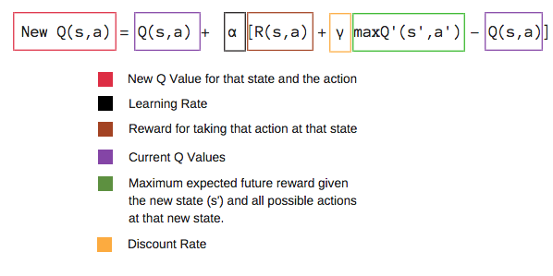
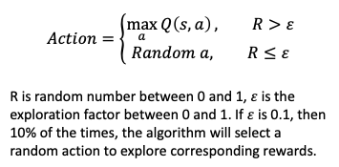
Method of Q-Learning
After transition to new state, a reward is generated, and the objective is to maximize the value of this reward over time
The next action is predicted based on the max q value for that state. Then the Q table is updated for each iteration append all the values in the Q matrix
Notes:
In order to enhance the q learning we use two types of moves which are exploitation and exploration. The agent can either exploit known states with high rewards or explore more of the state space. It’s important to maintain the balance between these two strategies to find efficient paths to optimal values.

Slide 7
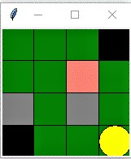
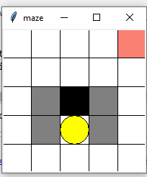
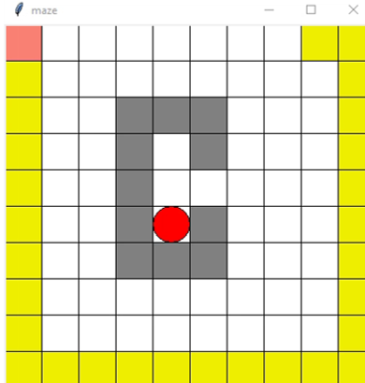
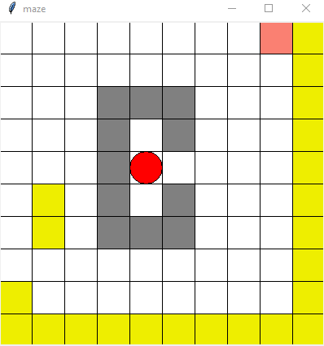
Environment
The environment created is split into 3 different grid sizes:
4x4 grid
5x5 grid
10x10 complex grid
10x10 standard grid
Notes:
This is the environment that I’ve developed. The orange rectangle is the agent, grey, black and yellow colored agents are the wall and pits. The agent can move in four directions which is UP,DOWN , RIGHT AND LEFT. When the agent reaches the goal a positive reward is given.

Slide 8
Parameters and Q-Table
Sample Q-table for 10x10 grid:
Values after tuning:
States Actions | 0 | 1 | 2 | 3
[0.0, 0.0, 40.0, 40.0] | -0.02 | -0.02 | -0.02 | -0.02
[40.0, 0.0, 80.0, 40.0] | 0 | -0.02 | 0 | 0
[40.0, 40.0, 80.0, 80.0] | -0.0392 | -0.05936 | -0.032 | -0.05504
[80.0, 40.0, 120.0, 80.0] | -0.0392 | -0.04 | -0.02 | -0.0392
[120.0, 40.0, 160.0, 80.0] | 0 | 0 | 0 | -0.02
[40.0, 80.0, 80.0, 120.0] | -0.04352 | -0.04352 | -0.04 | -0.0392
[40.0, 120.0, 80.0, 160.0] | -0.04611 | -0.032 | 7.168 | -0.02
[80.0, 120.0, 120.0, 160.0] | -0.04 | 0 | 32 | 0
[120.0, 120.0, 160.0, 160.0] | 0 | 0 | 0 | 0
[0.0, 40.0, 40.0, 80.0] | -0.02 | -0.04 | -0.03152 | 0
Parameters | Threshold
Epsilon | 0.9
Learning rate | 0.7
Discount factor | 0.9
Values before tuning:
Parameters | Threshold
Epsilon | 0.6
Learning rate | 0.4
Discount factor | 0.9
Notes:
Here you can see the Q table that’s generated for the 10x10 grid for two episodes.
In order toi employ smnoother learning process, the learning rate needs to be tuned as how much you accepts the new value vs the old value
On the other hand, after tuning the learning parameters of Q table, it is observed that the convergence is observed to be very fast for the learning rate especially.

Slide 9
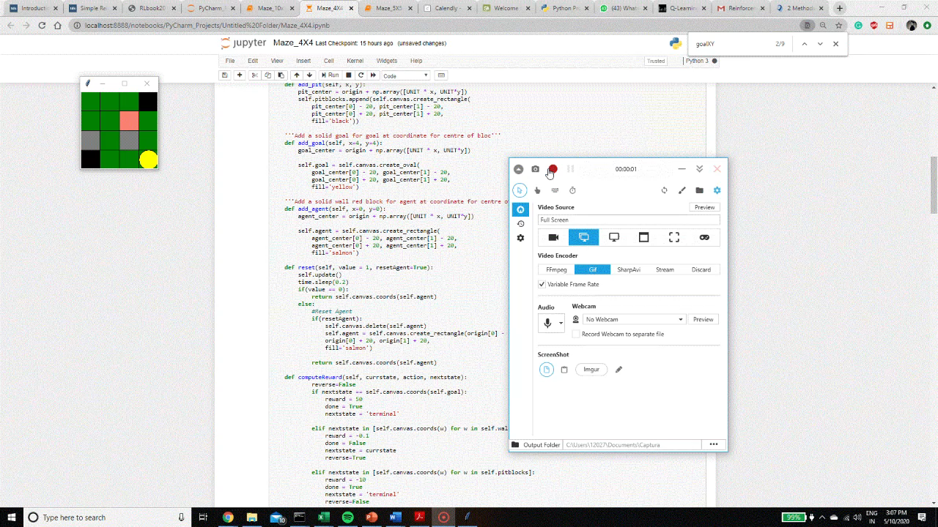
4x4 grid output
Maze Size ( 4X4 ) | Number
Average time of execution | 0.487 sec
Average Number of iteration | 15episodes

Slide 10
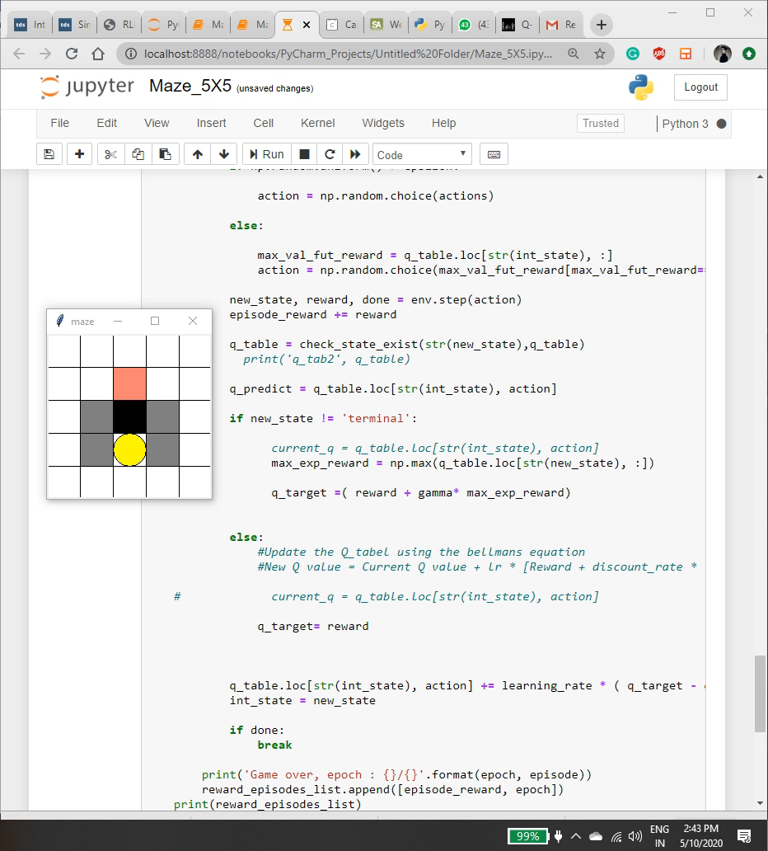
5x5 grid output
Maze Size ( 5X5 ) | Number
Average time of execution | 1.2712 sec
Average Number of iteration | 20 episodes

Slide 11
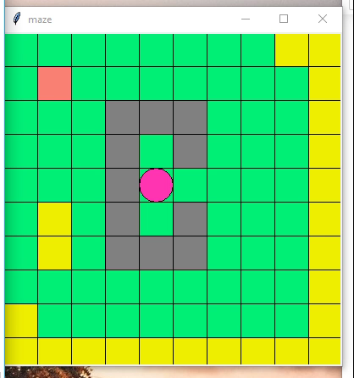
10x10 Standard space
Maze Size ( 10X10 ) | Number
Average time of execution | 2.4 sec
Average Number of iteration | 1250 episodes

Slide 12
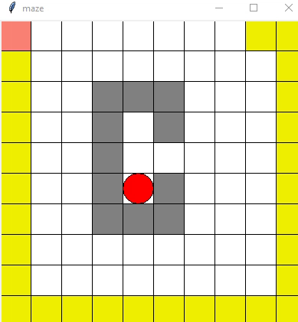
10x10 Complex space
Maze Size ( 10X10 ) | Number
Average time of execution | 3.7 sec
Average Number of iteration | 1600 episodes

Slide 13
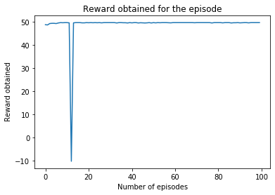
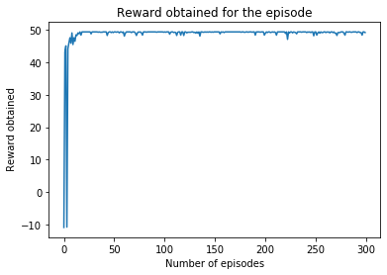
Plots for 4x4 and 5x5
Plot for 4x4 grid
Plot for 5x5 grid
Notes:
From the graphs, you can clearly observe that the, for a smaller grid space, it takes less than 20 iterations to converge for the agent to reach the goal after fine tuning.

Slide 14
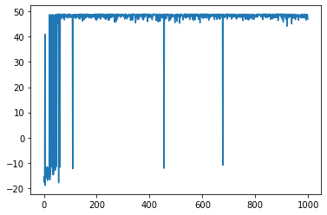
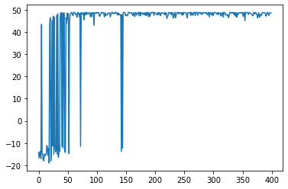
Plots for 10x10 grids
Complex 10x10
Standard 10x10
Notes:
The very fine irregularities in the graph is because of the reward that’s provided for the empty cell as negative. This is because, for a larger grid space the agent learns quick.

Slide 15
Analysis
Upon Observation, for a 10x10 grid it is observed that tuning the learning rate has a lot of affect in the rate of convergence of the algorithm.
For a complex tasks with huge grid space, Q learning isn’t the first choice because of the memory usage and time inefficient. Markov’s decision process or a Deep reinforcement would work better.
Also, the agent always tries to take the optimal path during learning. This does allow the agents to adapt to new strategies.
Notes:
Also, as Q learning is off policy algorithm

Slide 16
References
1.https://ieeexplore.ieee.org/stamp/stamp.jsp?tp=&arnumber=5967320
2. IEDProjects2015@IIITD
3.http://www.mitchellspryn.com/2017/10/28/Solving-A-Maze-With-Q-Learning.html

Slide 17
THANK YOU!

